Slide 1
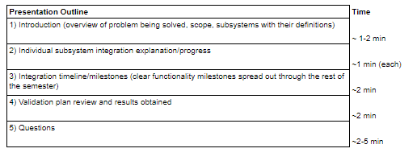
Notes:

Slide 2
Radio Frequency Signal Generator
By: Ethan Cura, Abel Gonzalez, Joseph Hinz and James Taylor
Notes:
James

Slide 3
Purpose
The goal of this project is to supplement the existing market with a low-cost RF signal generator for students and enthusiasts.
Notes:
James

Slide 4
Technical Summary
The signal generator shall have a frequency range between 1 and 500MHz with 1Hz precision.
The signal generator shall be able to frequency and amplitude modulate this carrier frequency.
The signal generator shall minimize any spurious signals for a spectrally pure output.
Notes:
Abel

Slide 5
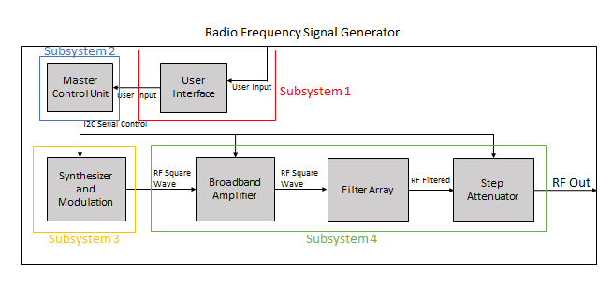
System Overview
Subsystem 1: Ethan Cura
Subsystem 2: Abel Gonzalez
Subsystem 3: Joseph Hinz
Subsystem 4: James Taylor
Notes:
Ethan

Slide 6
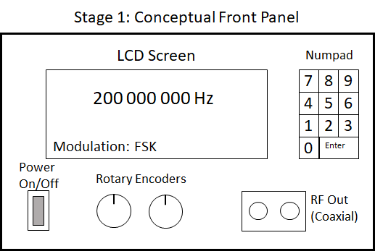
Subsystem 1: User Interface

Slide 7
Subsystem 1: Integration
Design/buy a simple metal housing to mount instruments
Redesign UI board in order to allow UI elements to mount to the front panel
Design a new MCU board in order to distribute power to other subsystems
Connect the MCU board to all subsystems via ribbon cables to send and receive control signals

Slide 8
Subsystem 1: Integration Progress
Board Redesign has started this week, otherwise no progress
We will leverage what we learned about the UI elements from last semester to make the design process more efficient/effective

Slide 9
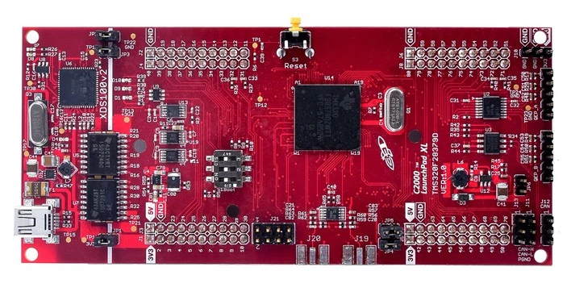
Subsystem 2: Master Control Unit
Notes:
Controls the synthesizer, modulation, filter selection, and appropriate attenuation
Abel

Slide 10
Subsystem 2: Integration
Develop code that will allow the MCU to interface with digital I/O such as the rotary encoders and numpad
Develop code that will allow the MCU to communicate/control I2C components such as the character display and synthesizer
Develop a menu that allows the user to control the completed device through the UI

Slide 11
Subsystem 2: Integration Progress
Digital I/O still needs to be tested on the UI elements we intend to use
I2C code compiles but does not communicate properly with I2C devices
Menu can only be developed after I2C communication with the LCD screen is established

Slide 12
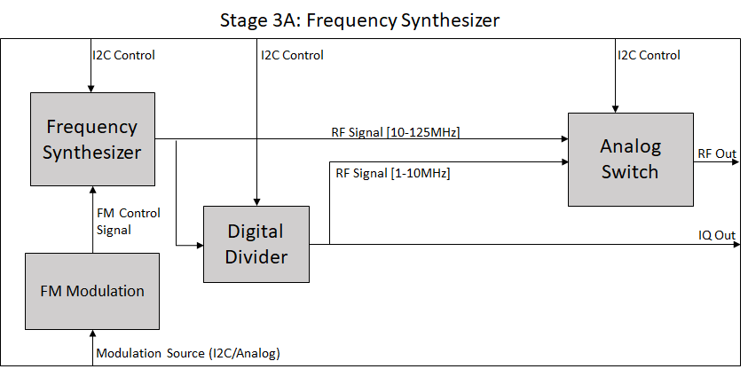
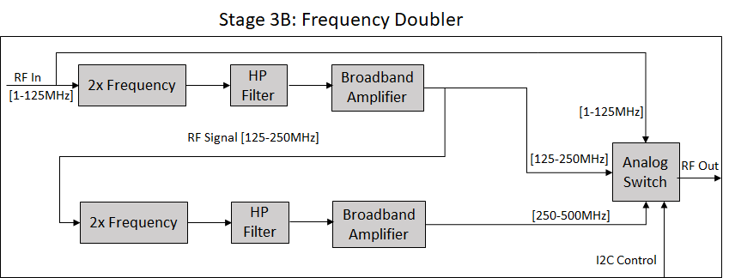
Subsystem 3: Synthesizer and Modulation
Notes:
Joe

Slide 13
Subsystem 3: Integration
Subsystem 3 will be controlled via I2C through a ribbon cable from the MCU board
Power will also be supplied from the MCU board
The output of subsystem 3 will be passed to Subsystem 4 through a coaxial cable

Slide 14
Subsystem 3: Integration Progress
At this point Subsystem 3 works as intended
Communication through I2C has been tested successfully using a different MCU control board (Arduino)
Output signal from Subsystem 3 through a coaxial cable has been successfully tested
Power connection to MCU board will be accomplished using two jumper wires once the MCU board is redesigned

Slide 15
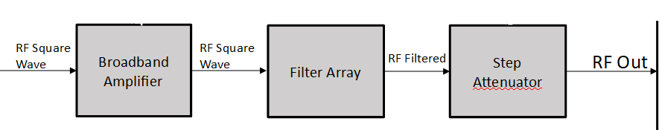
Subsystem 4: Broadband Amplifier/Filter Array/Step Attenuator
Amplifier increases the power of the carrier/modulated signal
Filters remove unwanted harmonics from square wave signal to produce a sinusoidal carrier
Attenuators reduce signal power to the user defined output power
Notes:
James

Slide 16
Subsystem 4: Integration
Subsystem 4 will be controlled via I2C through a ribbon cable from the MCU board
Power will also be supplied from the MCU board
The output of subsystem 4 a coaxial terminal

Slide 17
Subsystem 4: Integration Progress
Amplifier and filter boards (but not the attenuator board) have been fabricated
Two of the filter boards and the amplifier board are mostly assembled
Have begun testing on these boards
Notes:
James

Slide 18
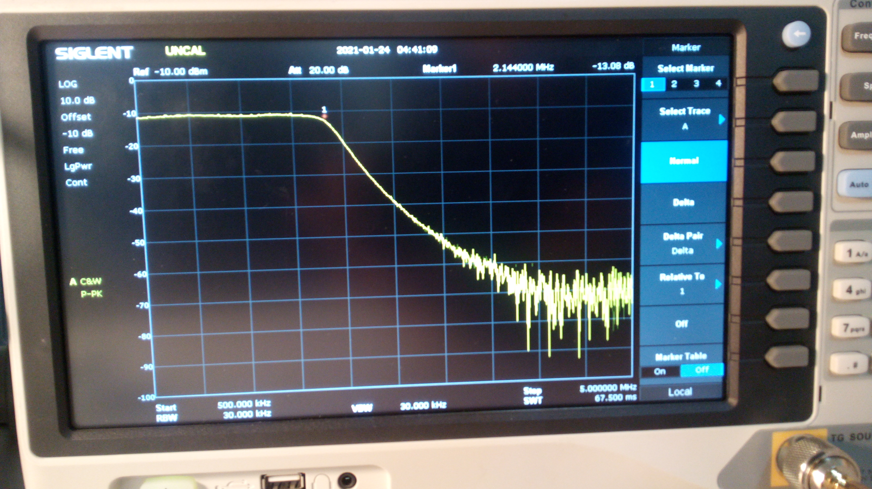
Results (1-2MHz)
Notes:
James

Slide 19
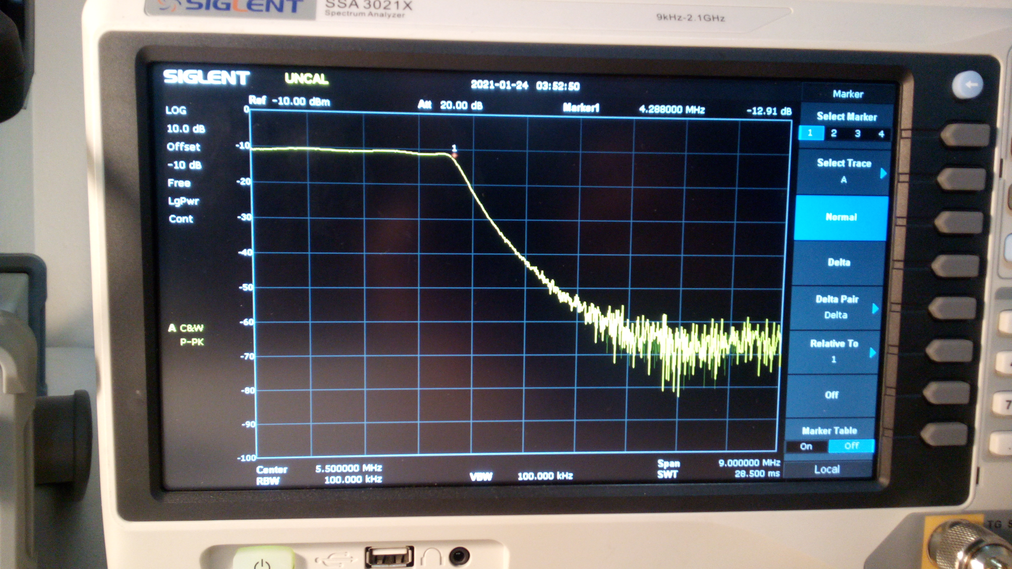
Results (2-4MHz)
Notes:
James

Slide 20
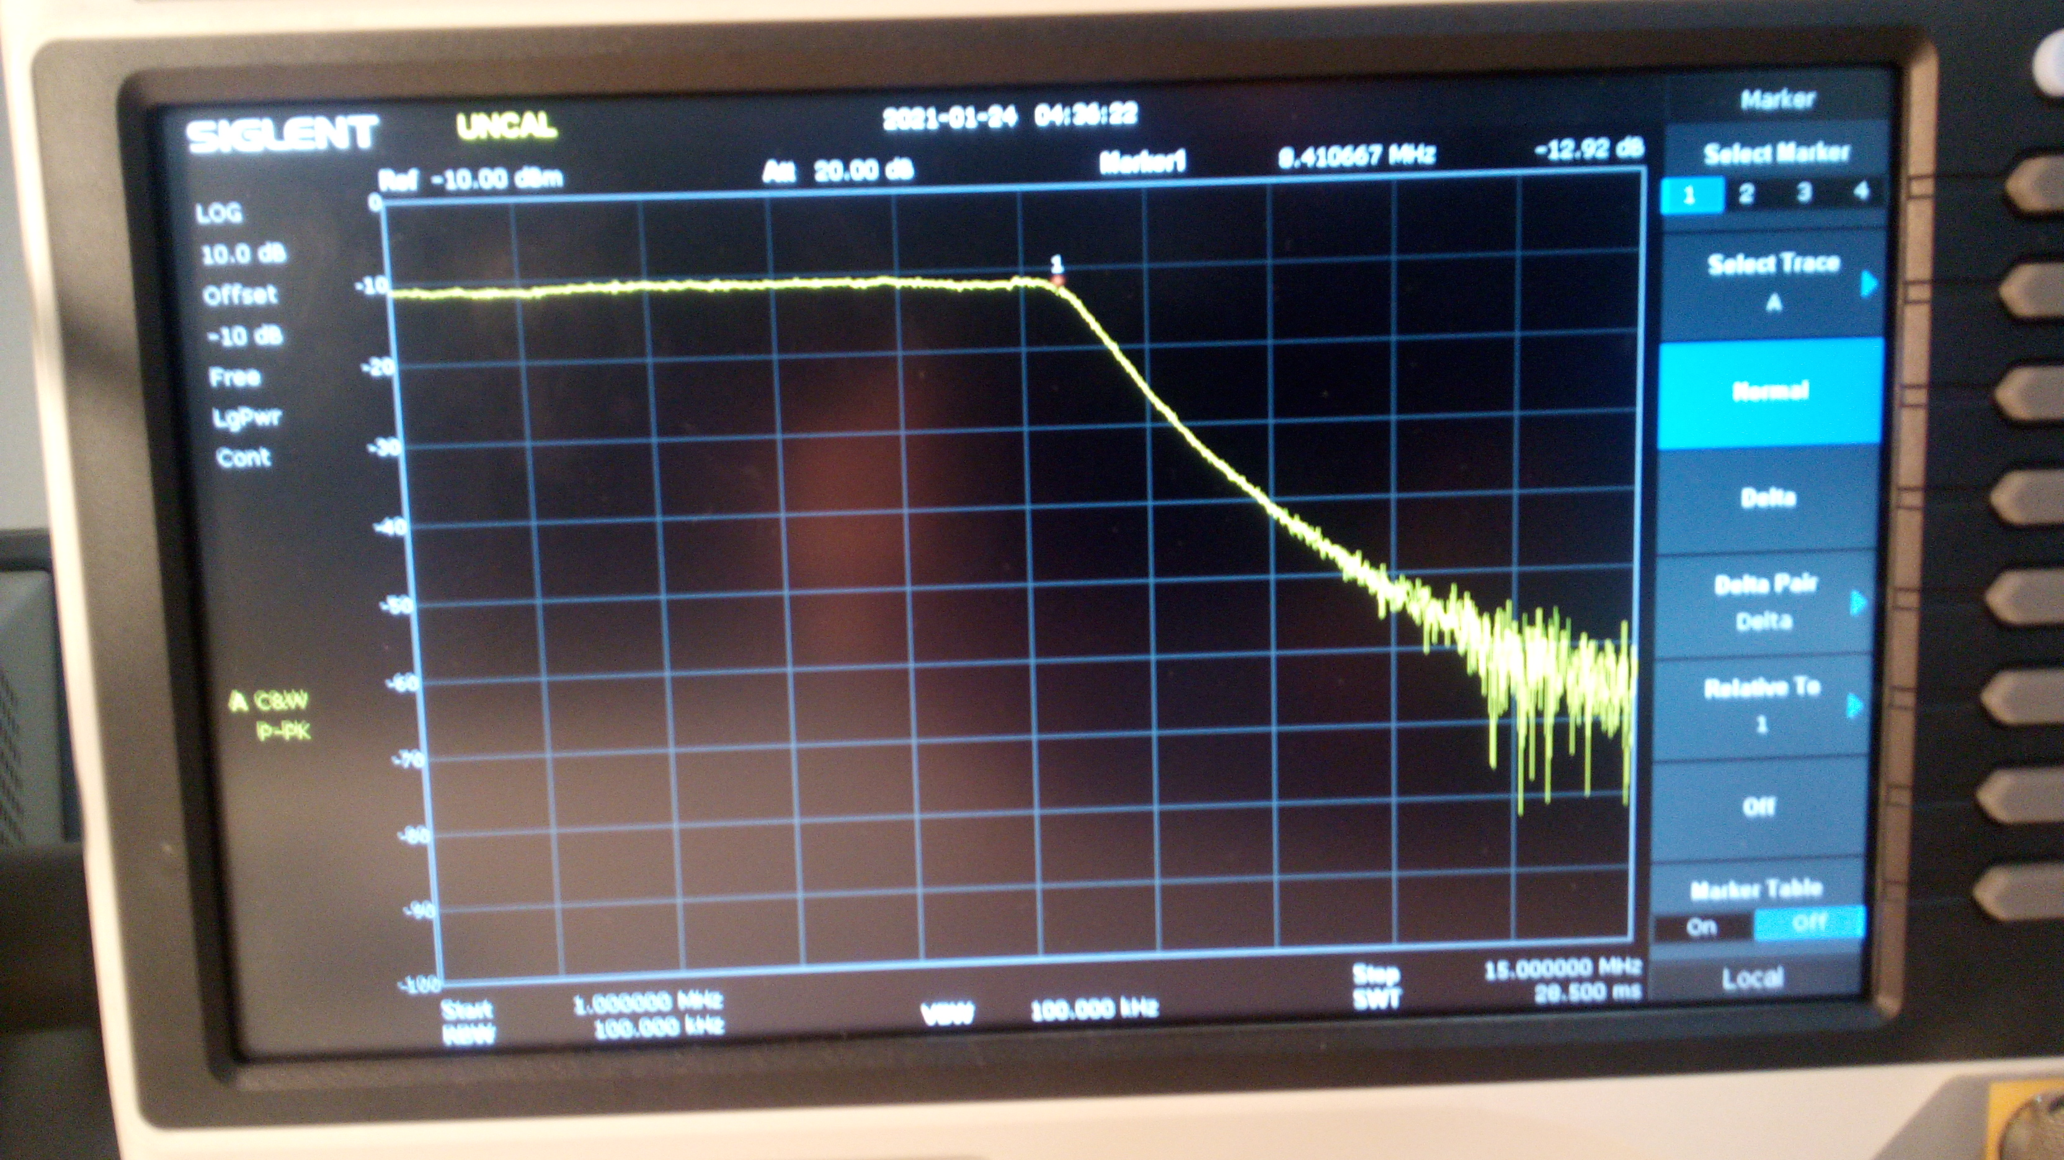
Results (4-8MHz)
Notes:
James

Slide 21
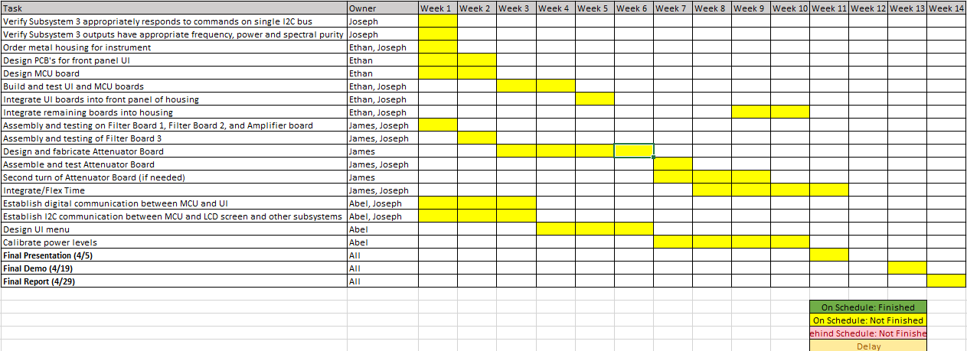
Integration Timeline

Slide 22
Validation Results
New results since last semester:
No results from Subsystem 1 and 2 at this time
Subsystem 3 has had improvements in the lower frequency bands and issues with I2C control on the Doubler board have been resolved
Several filters have been built and tested on their PCBs showing expected frequency response
Relays for selecting filters have been successfully controlled manually

Slide 23
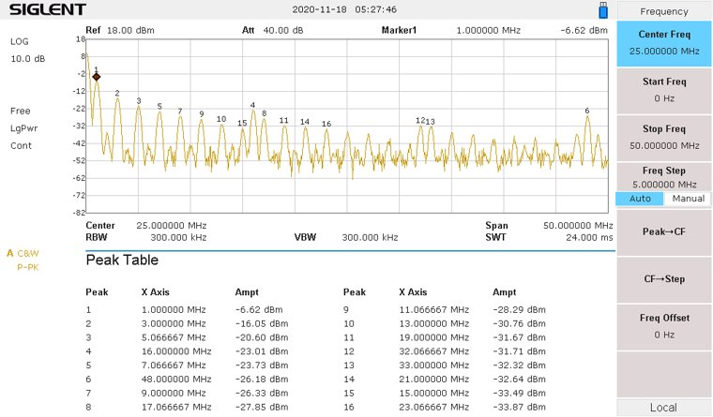
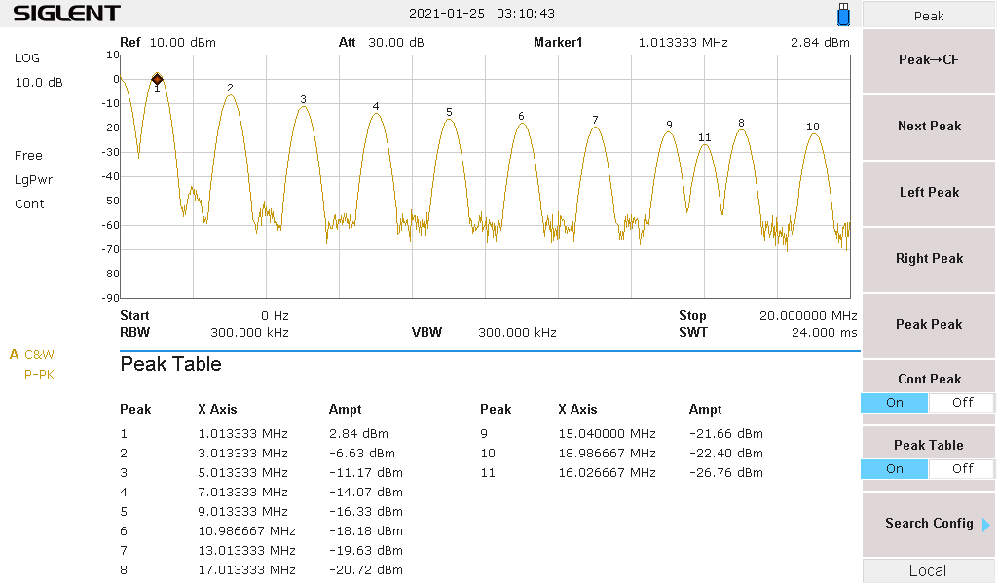
Subsystem 3 LF Improvements

Slide 24
Questions

Slide 25
Thank You

